Slide 1

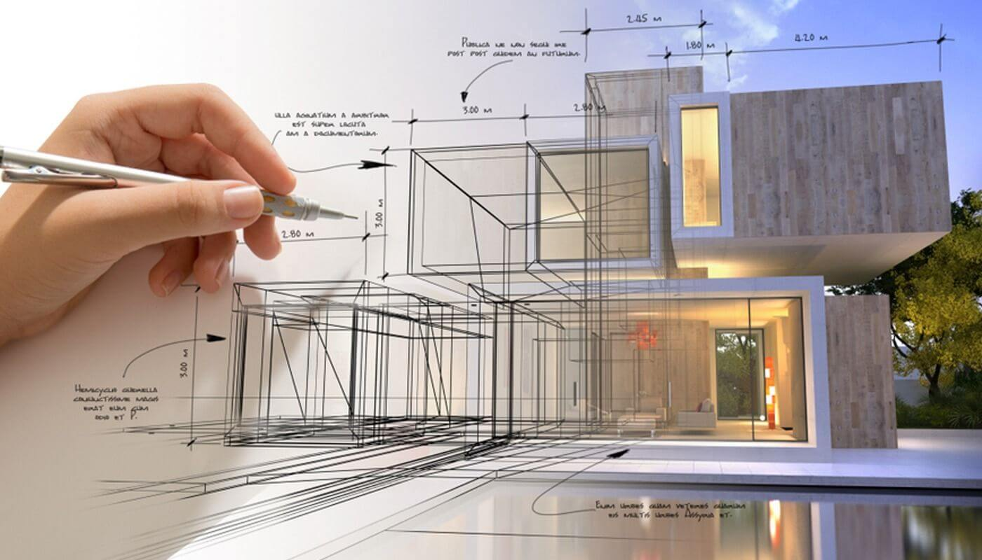
Comparative analysis of G+4 structure with and without floating column
Project Supervisor: Presented by:
Prof. Pratyush Prakash Mayank 20143
Divyanshi Diwakar 20128
Pradeep Gond 218103
Swantaj Kr. Yadav 218105

Slide 2

CONTENTS
Introduction
Problem Definition
Objectives
Literature Review
Key Aspects
Methodology
Modelling Details of Building
Model Details
Geometric Designs
Earthquake Load Parameters
Results and Discussion
Project Timeline
References

Slide 3
INTRODUCTION
The construction industry continually explores innovative approaches to enhance the structural performance and efficiency of buildings. This project undertakes a thorough comparative analysis of a G+4 RC building, focusing on the impact of incorporating floating columns.
As a part of urbanization, multi-storey building with different architectural requirements are constructed. These requirements are nothing but soft storey, floating column, heavy load, the reduction in stiffness etc.
Nowadays most of the urban multi-storey buildings have open first storey as an unavoidable feature. For a hotel or commercial building, where the lower floors contain halls, conference rooms, lobbies, show rooms or parking areas, large interrupted space is required for the movement of people or vehicle.

Slide 4
Typically it is required to provide large spacing between the columns to entertain the requirement of uninterrupted spaced. These functional requirements are fulfilled by providing floating column but the structural behaviour of the building changes abruptly.
The beams supporting the floating column require more flexure and shear demand than the surrounding beams, it leads to stiffness unevenness at a specific joint.
Columns are the main structural elements that resists the lateral load in rigid frame and have the importance in the performance of the building under earthquake load.
The response of a building under earthquake excitation depends upon the geometry, shape and size of the building. These loads produced in a building at various floors height are required to bring down along the top to soil strata through the shortest way.
The load transferring path having any discontinuity causes poor functioning of the building. A specific storey of a building with lesser columns and walls is likely to be detrimental.

Slide 5
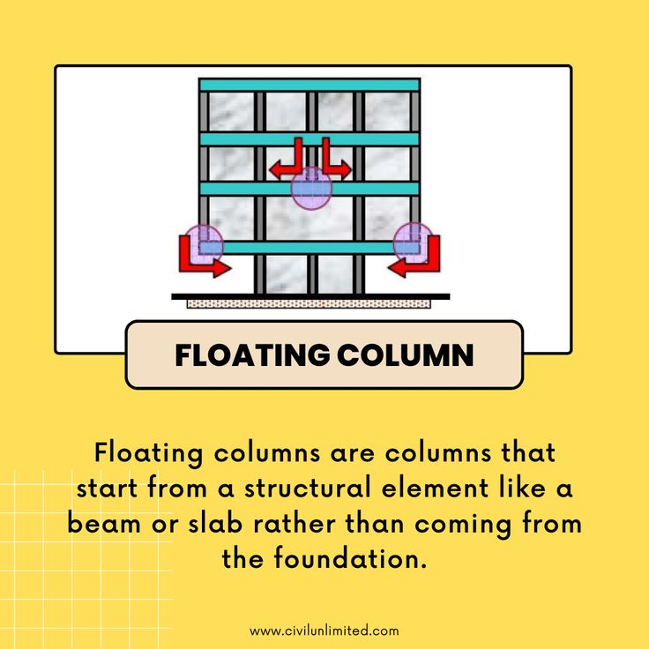
FLOATING COLUMN
A floating column or hanging column or stub column, which at its lower level rests on a horizontal member, beam.
These columns are placed in such a way that it hangs on a base having no fixed support to transfer the load to foundation.
It transfers the load to the beams (transfer beams) and these beams transmit the force to other columns.
The depth of these transfer beams is taken more than the normal beams; generally between 0.6m to 1m.

Slide 6
Extended 3D Analysis of Building System Software
ETABS is a Building Information Modeling (BIM) software application for building structural analysis and design.
Models three dimensional structures.
Analyses linear and non linear behavior.
Considers static and dynamic loads, including seismic forces.
Optimizes structural designs and ensures structural safety.

Slide 7
PROBLEM DEFINITION
The project aims to investigate the comparative performance and implications of incorporating floating columns in building structures versus traditional designs. Key objectives include evaluating structural stability, cost analysis, space utilization and seismic stability of the structure. The study seeks to provide insights into the advantages, challenges, and overall feasibility of implementing floating columns, contributing valuable information for optimized and resilient building design practices.
Key aspects of the problem :
Structural performance evaluation
Economic analysis
Optimal placement strategies
Material utilization
Applicability across building types

Slide 8
OBJECTIVES
To investigate the performance of RC building consisting of floating columns and without floating columns.
To correlate the performance of RC buildings consisting of floating columns inward and at the corners of the building.
To compute the lateral displacement, storey drift and storey shear by using ETABS.
Finding the optimum location of floating column in a multi-storey building.

Slide 9
LITERATURE REVIEW
Citations | Key Findings
S K Singh, Sarv Priya, Mohd Nadeem, Md Badar Alam (2021) https://iopscience.iop.org/article/10.1088/1755-1315/889/1/012008/pdf | The response of a G+5 building model in zone V with and without floating column is analyzed. Evaluation of the building results in the form of lateral displacement, storey shear and storey drift using ETABS software. It was observed that floating column should be avoided in high rise building constructed in seismic zones III and above. Storey displacement increases with increase in load on floating column. Storey shear decreases in the presence of floating column due to the reduction of mass of column in the structure. An increase in the size of the beams and column is preferred to improve the performance of building with floating column to reduce the storey displacement and storey drift.

Slide 10
Citations | Key Findings
Akshay Gujar, H S Jadhav (2019) https://www.academia.edu/download/60514831/IRJET-V6I394920190907-103300-i1pvr0.pdf | This paper was focused on multi-storey RCC structure with floating column in seismic zone IV. The general linear static analysis with the assumption that the structure are having total load once the whole structure is constructed completely. But in actual condition, buildings are constructed storey by storey and all at once. Hence it is observed that effect due to sequential loading is different than actual analysis. The study is based on the sequential construction analysis which accounts for the concept of incremental loading. With considerations for IS 1893-I for seismic loading and special RC moment resisting frame (SMRF). The results showed a 10-13% increase in deformation of floating column located at corners than column located at the middle of the frame

Slide 11
Citations | Key Findings
Gaurav Pandey, Sagar Jamle (2018) https://www.academia.edu/download/57726289/IRJET-V5I10181.pdf | This paper is focused on the analysis of normal building with different storeys ranging from G+14 to 20. Different positions of floating column are compared to analyze the nodal displacement and storey drift for the respective positions of the floating column. The method used for the analysis is Response Spectrum Analysis which uses the non linear approach. Study models are examined for longitudinal as well as transverse direction of seismic loads as per the response spectrum method of IS code 1893-I 2002. The study shows that the optimum location for positioning of the floating column is at the corners of the frame.

Slide 12
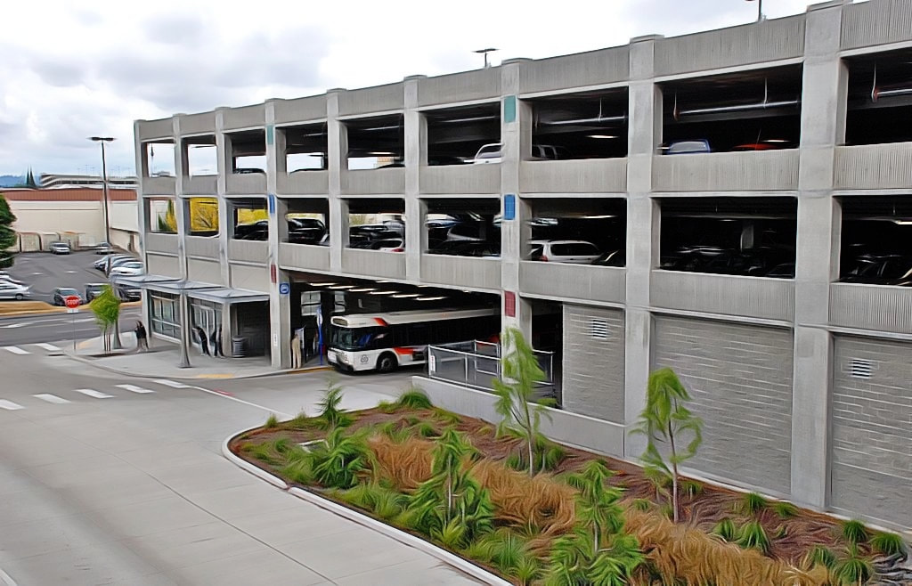
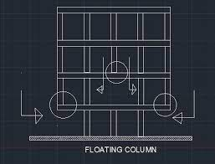
KEY ASPECTS OF THE PROBLEM
STRUCTURAL MODELING
To develop detailed structural models for the G+4 building both with and without floating columns using ETABS software.
Define material properties, geometry, architectural data, loading conditions and other relevant parameters
FLOATING COLUMN PLACEMENT
To investigate the effects of floating columns by placing them inwards and at the corners of the building frame in separate analyses.
To examine how these variations impact the structural behavior, stability and load distribution

Slide 13
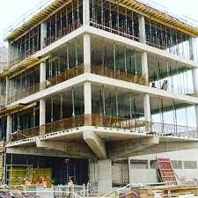
PERFORMANCE METRICS
To utilize ETABS to calculate lateral displacements storey drift and storey shear for both the building configurations.
To compare and analyze the obtained results to assess the structural performance differences.
SEISMIC ANALYSIS
Conducting seismic analysis to evaluate the seismic resistance of the structure with and without floating column.
To assess the impact of floating column on the building’s response to seismic forces.

Slide 14
METHODOLOGY
The modeling of the building is being done using the ETABS software, following the codes IS 456-2000 and IS 1893-2002(part I).
As per IS 1893-2002, clause 6.2, assumptions for the Earthquake resistant design of structures are followed, and as per the clause 6.3.1.2 the load combinations are accounted as:
1.5(DL+IL)
1.2(DL+IL+EL)
1.5(DL+EL)
0.9DL+1.5EL
As per IS 1893-2002, moment resisting frames are designed independently to resist at least 25% of the design base shear.

Slide 15
MODELLING DETAILS OF THE BUILDING
For analysis and study purpose there are a few models developed such that a multi-storey building that is Stilt+G+4 building is considered and modelled into two types.
There is a multi-storey building without floating column that is a normal building and the other type is a multi-storey building with floating columns placed at different positions.
Among these two types of models, the multi-storey building without floating column is considered constant comparing it with the models developed as multi-storey building with floating column where these floating column are present at different portions of the building analyzing it at different zones as zone 5 to zone 2 as per codal provisions.
The analytical models of the building include all the component that influence the mass, strength, stiffness and deformability of the structure.

Slide 16
ETABS is a standalone finite element based structural program for the analysis and design of civil structures and which is a fully integrated program that allows model creation, modification, execution of analysis, design optimization, and results review from within a single interface and thus used for the analysis of all structural systems by linear static method for zones II and V.
Hence the results are tabulated by focusing the parameters like lateral displacements, base shear and story drift.
From the “Response Spectrum Analysis” when compared shows the best results. This is explained as, The earthquake response spectrum analysis is the most popular method in the seismic analysis of the structures.
There are computational advantage for prediction of displacements and member forces in the structural systems using the response spectrum method.

Slide 17
This method involves in the calculation of the maximum values of the displacements and member forces in each mode of vibrating using smooth design spectra that are the average of several earthquake motions.
The response spectrum analysis of the multistorey building with floating column at different positions of the building is done as per the code IS 1893-2002(part 1) the response spectrum analysis of multi-storey building and is summarized.

Slide 18
MODEL DETAILS
Model 1: Stilt+G+4 building without floating column i.e. normal building analyzed from zone 5 to zone 2.
Model 2: Stilt+G+4 building with floating columns placed at the edges, analyzed from zone 5 to zone 2.
Model 3: Stilt+G+4 building with floating column at the centre position, analyzed from zone 5 to zone 2.
Model 4: Stilt+G+4 building with floating column at parallel positions, analyzed from zone 5 to zone 2.
Comparison of the results observed in the two models that is Maximum displacements, Story drifts, Response spectrum analysis, of the normal building and the floating column building are summarized.

Slide 19
GEOMETRIC DESIGN OF BUILDING
Member dimensions
slab | Thickness |  |  |  | 120mm
Beams | Normal building |  |  |  | 230x480mm
 | Floating column building |  |  |  | Varies between 230x480mm to 230x600mm
columns | Normal building |  |  |  | 400x400mm
 | Floating column building |  |  |  | Varies between 400x400mm to 600x600mm
Brick infill wall thickness | Exterior wall |  |  |  | 250mm
 | Interior wall |  |  |  | 150mm
Shear wall thickness |  |  |  |  | 250mm
Loads
Unit weight of concrete |  |  |  |  | 25kN/m²
Unit weight of brick infill |  |  |  |  | 20kN/m²
Floor loads |  | Live |  |  | load | 3.5
 |  | Dead |  |  | load | 1
Roof loads |  | Live |  |  | load | 1.5
 |  | Dead |  |  | load | 1
Grade of rebar
Beams |  |  |  |  | Fe 415
Columns |  |  |  |  | Fe 415

Slide 20
PARAMETERS OF EARTHQUAKE LOAD CONSIDERED FOR THE STUDY
Parameters |  | Values
Seismic Zone Factor | ZONE 5 | 0.36
 | ZONE 4 | 0.24
 | ZONE 3 | 0.16
 | ZONE 2 | 0.10
Importance Factor |  | 1.0
Response reduction factor |  | 5.0
Percentage of damping |  | 5%
Soil type |  | Medium soil

Slide 21
RESULTS AND DISCUSSIONS
A comparative study and analysis is performed between a normal column building that is the building with all regular columns and other structural and non-structural members in it and on the other hand a floating column building at various zones as per the specifications in IS1893-2002(part I).
A detail study is carried out on the floating column building to find out the variations in the structural response of the building with floating columns at “parallel positions, at one edge column position and at the centre portion”, observed from the parameters like maximum displacements in the building at each floor, story drifts and the results obtained are beyond the deformation limits.
A floating column building tend to fail in extreme earthquake zones, thus some recommendations are performed to analyse the building response in that case. The recommendations followed are shear walls, infill walls, Steel bracings and the designed frame is a moment resisting frame for the analysis of the building in these conditions.

Slide 22
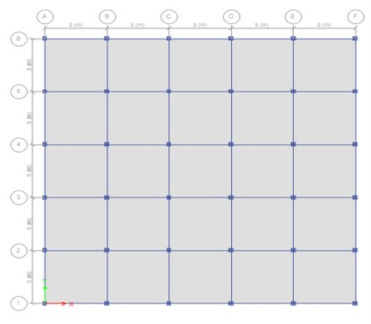
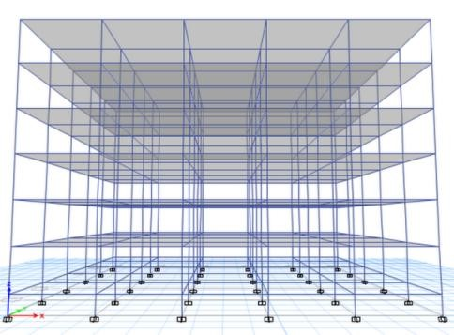
Model 1: Stilt+G+4 building without floating column i.e. normal building analysed from zone 5 to zone 2
In this model, Normal building frame is designed and analysed considering the parameters like maximum displacements and story drifts in X and Y directions, Column P-M-M interaction rations are observed and response spectrum analysis is also observed.
The figures shown below are the plan and elevation view of the normal building.
Plan view of the normal building Elevation view of the normal building

Slide 23
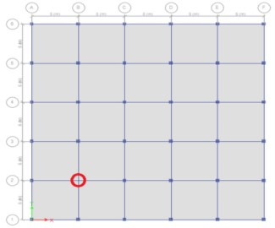
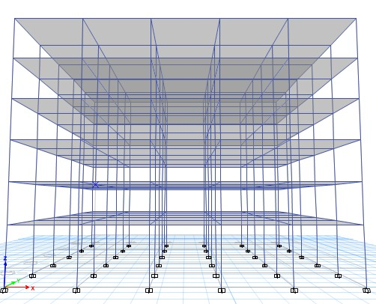
Model 2: Stilt+G+4 building with floating column at Edge column position, from zone 5 to zone 2
In this model, the floating column at a Edge column position is designed and analysed by considering the parameters like maximum displacements and story drifts, Column P-M-M interaction ratios.
Plan view of the floating column at Edge column Elevation view of the floating column at Edge position from zone 5 to zone 2 position from zone 5 to zone 2

Slide 24
In this model if we compare the maximum displacements and story drifts obtained for the normal building frame, the floating column building frame shows higher displacements and story drifts, thus observing the results we can understand that the presence of floating column in any Edge column position in the building can give the higher values of forces acting on it, resulting in the increase of building failure condition in higher seismic areas, where higher seismic excitations can be obtained.

Slide 25
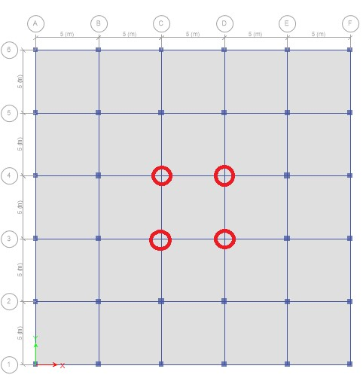
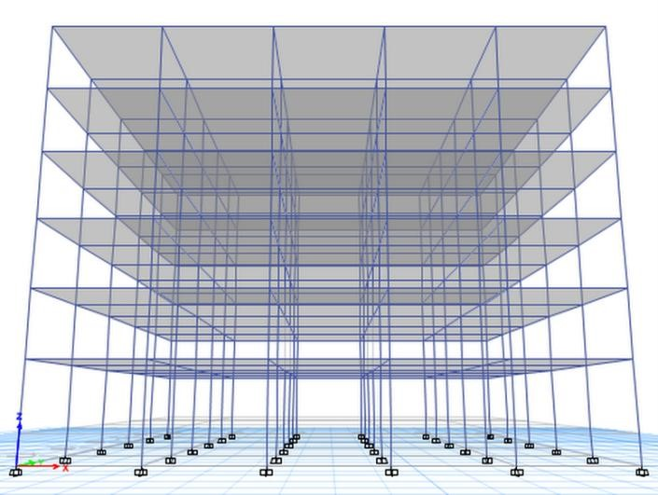
Model 3 : Stilt+G+4 building with floating column at Centre portion, from zone 5 to zone 2
In this model, the floating column is present at the centre portion of the frame modelled and analyzed. The results obtained are by considering the parameters like maximum displacements and storey drifts of the structure modelled.
Plan view of the floating column at centre Elevation view of the floating column at centre column column position from zone 5 to zone 2 position from zone 5 to zone 2

Slide 26
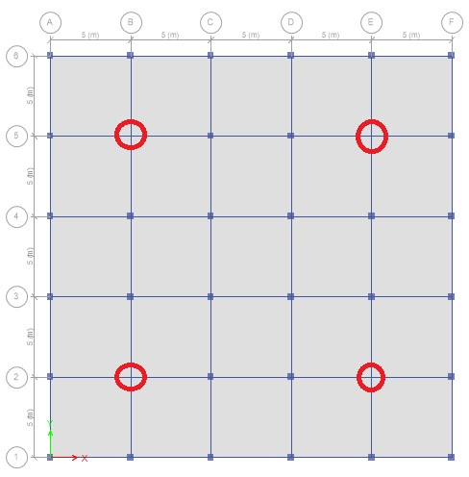
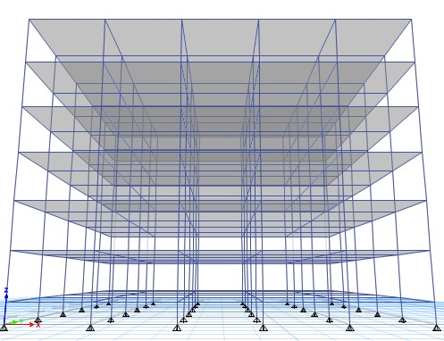
Model 4: Stilt+G+4 building with floating column at Parallel positions, from zone 5 to zone 2
In this model, the floating column are present at the parallel positions of the frame and the results are obtained from the parameters considered from the analysis such as maximum displacements and storey drifts.
Plan view of the floating column at Elevation view of the floating column at parallel
parallel column position from zone 5 to zone 2 column position from zone 5 to zone 2

Slide 27
REFERENCES
Analysis of G+5 storeys building with and without floating column
S K Singh, Sarv Priya, Mohd Nadeem, Md Badar Alam
https://iopscience.iop.org/article/10.1088/1755-1315/889/1/012008/pdf
Performance of a multistorey RCC structure with floating column
Akshay Gujar, H S Jadhav
https://www.academia.edu/download/60514831/IRJET-V6I394920190907-103300-i1pvr0.pdf
Optimum location of floating column in multi-storey building with seismic loading
Gaurav Pandey, Sagar Jamle
https://www.academia.edu/download/57726289/IRJET-V5I10181.pdf

Slide 28
Thank you

